Slide 1
Online GPS II/MAPP
Meetings 1 – 10

Slide 2
Meeting 9 Teamwork and Partnership in Foster Care and Adoption

Slide 3
License Rights to OCFS
Center for Development of Human Services, Institute for Community Health Promotion, SUNY Buffalo State acknowledges the State of New York’s and the Office of Children and Family Services’ royalty-free, non-exclusive and revocable license to reproduce, publish, distribute, or otherwise use any and all material herein for the limited purpose of training GPSII/MAPP Leaders and for as long as such materials and such training are deemed appropriate by NYS OCFS.
The Children’s Alliance of Kansas (CAOK) is the current national owner of the copyrighted “toolbox” of MAPP programs. NYS Office of Children and Family Services (NYS OCFS)/Center for Development of Human Services (CDHS) has permission from CAOK to provide MAPP programs (GPSII/MAPP, Caring For Our Own, Deciding Together, Shared Parenting, Mini-MAPP, and Child Sexual Abuse) to certify leaders through leader certification workshops and directly to foster/adoptive parents in New York State.
In order to better meet the needs of children and families in New York State, PS-MAPP was revised in 2004 and renamed GPSII/MAPP. Further revisions were made in 2005 after considering the feedback from MAPP Leaders throughout the state, and minor revisions and reformatting occurred in 2009. Significant revisions to the content and updating to reflect best practice and legal changes in New York State were made and approved by NYS OCFS in 2012 for this edition.
© 2009 Children’s Alliance of Kansas. Revised with permission NYS OCFS.

Slide 4
Rules of the Road
Placeholder

Slide 5
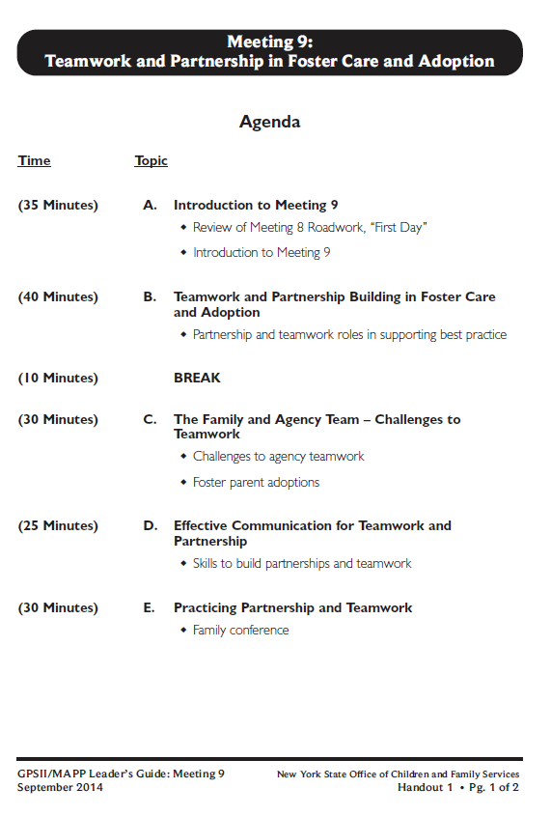
Let’s look at:
Handout 1

Slide 6
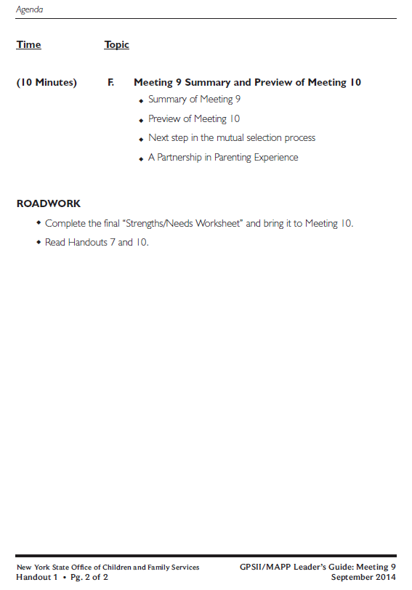

Slide 7
Roadwork from Last Meeting:
Meeting 8 Handout 10, Creating an Eco Map-Worksheet
What were the benefits of completing your Eco-Map?

Slide 8
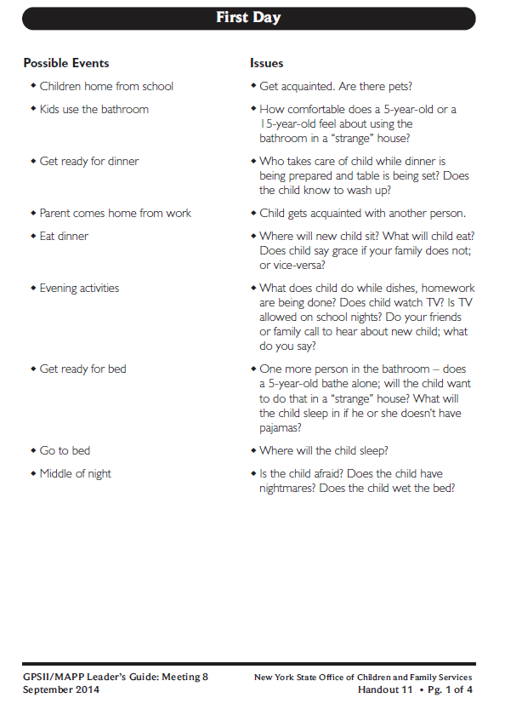
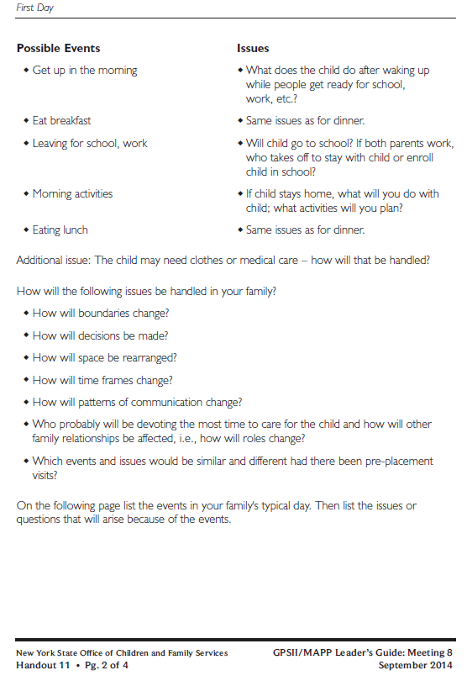
Roadwork from Last Meeting:
Meeting 8 Handout 11, First Day

Slide 10
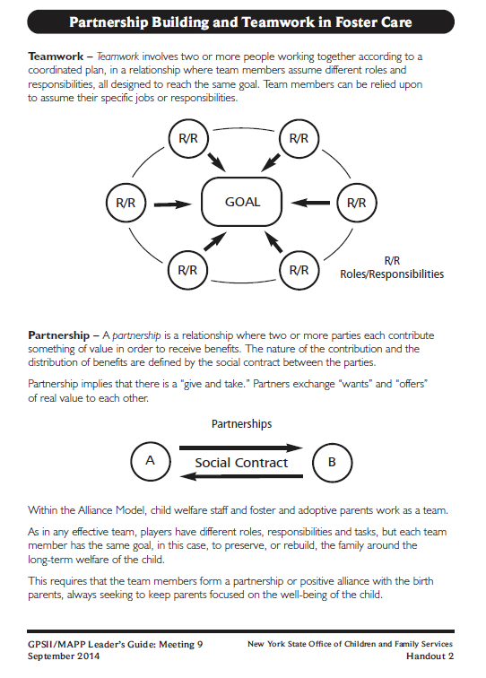
Let’s look at: Handout 2

Slide 11
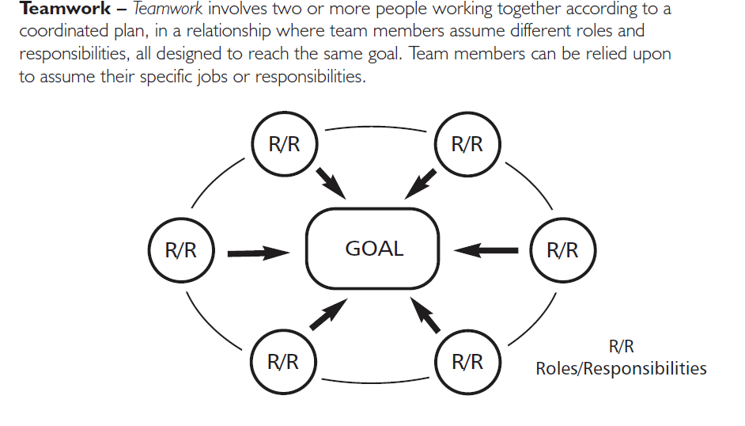

Slide 12
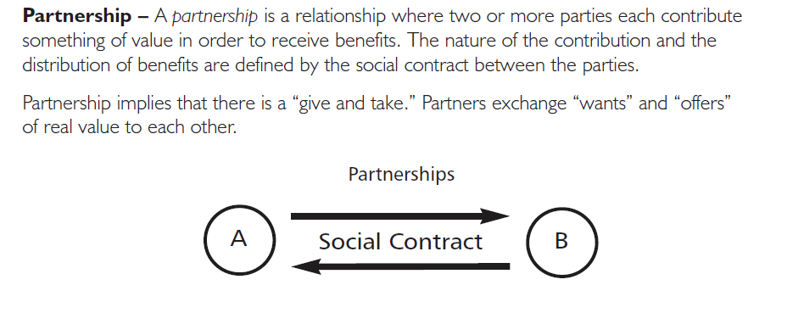

Slide 14
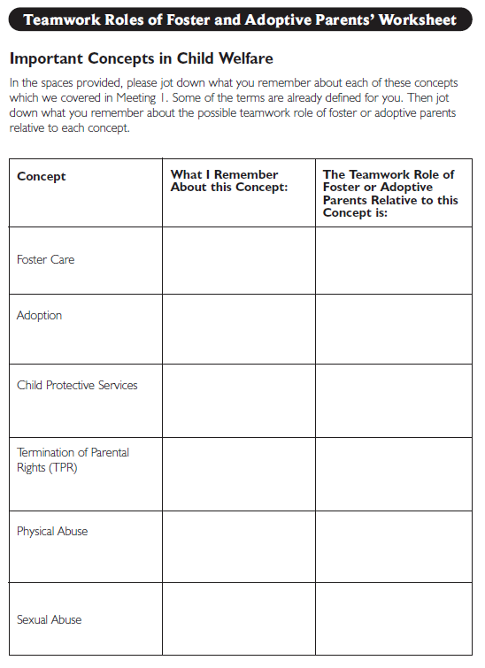
Roadwork from Last Meeting: Meeting 8 Handout 12

Slide 15
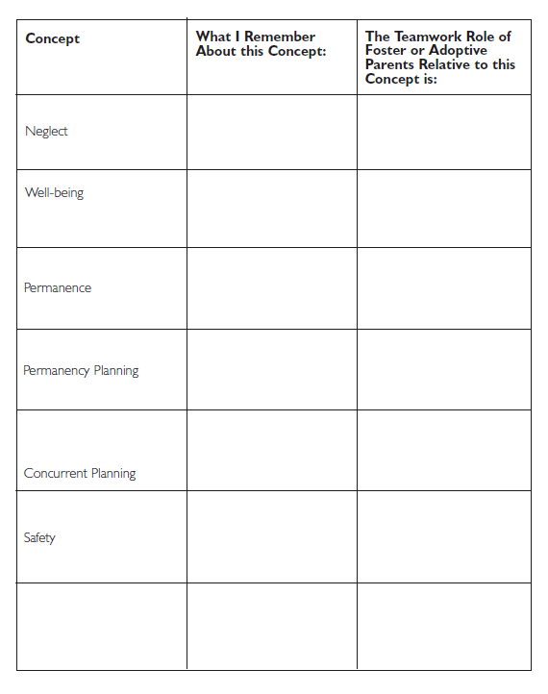
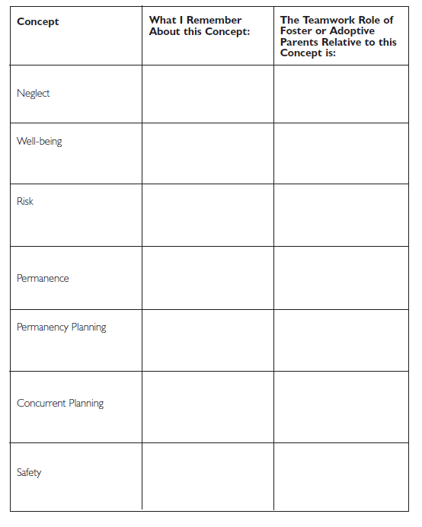

Slide 16
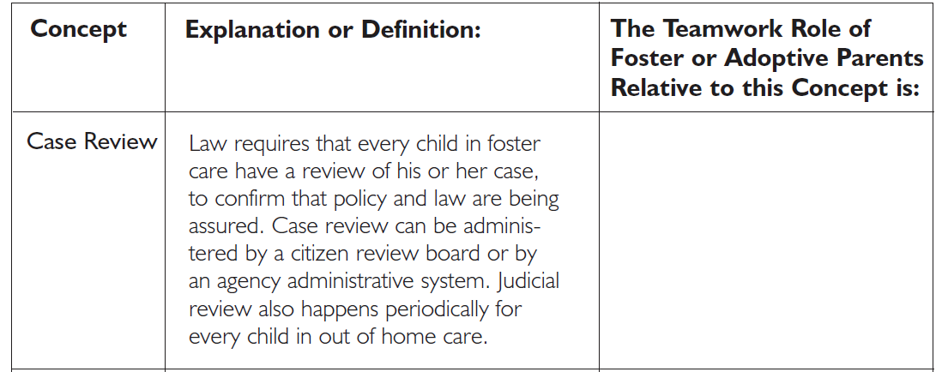
Case Review

Slide 17
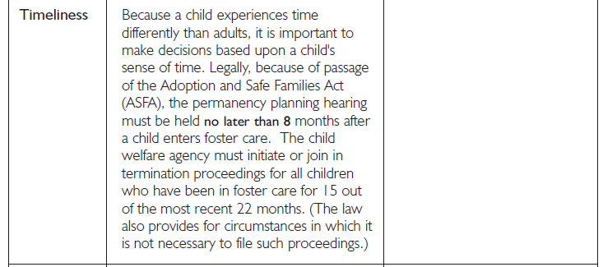
Timeliness

Slide 18
Reasonable Efforts

Slide 19
Full Disclosure

Slide 20
Searching for Relatives

Slide 21
Case or Family Conferencing

Slide 22
Permanency Hearing

Slide 23
Confidentiality

Slide 24
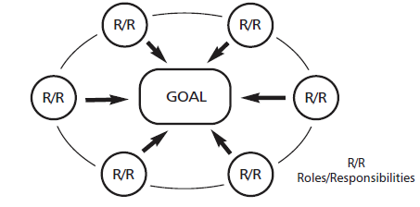
Agency & Foster/Adoptive Family Teamwork Needs and Challenges:

Slide 25
Foster Parent Adoptions
In 1975, over two-thirds of the states required foster parents to sign a statement stating that they would not pursue adopting a child in foster care.
Today, foster parents are the number one adopters of children in foster care.
Research suggests that foster parents who have contact with the parents of children in foster care are more likely to decide to adopt.

Slide 26
Foster Parent Adoptions
Advantages
One less move for the child
Foster family already know the child’s strengths & needs
Foster family may know the child’s birth family and be better able to help the child deal with past losses
Challenges
Foster family intends all along to adopt and sabotages work done to help the child and parent unite
Agency may lose a foster family resource
Foster family feels pressured to adopt when they are not ready

Slide 27
Definition of Attachment
Attachment is the affectionate and emotional tie between people that continues indefinitely over time and lasts even when people are geographically apart.*
* Fahlberg, Vera. “Attachment and Separation” PROJECT CRAFT, Training in the Adoption of Children with Special Needs. Ann Arbor, MI: University of Michigan School of Social Work, 1980, pp. V-1 - V-93.

Slide 28
Definition of Attachment*
Attachment is the affectionate and emotional between people that continues indefinitely over and lasts even when people are
* Fahlberg, Vera. “Attachment and Separation” PROJECT CRAFT, Training in the Adoption of Children with Special Needs. Ann Arbor, MI: University of Michigan School of Social Work, 1980, pp. V-1 - V-93.

Slide 29
What does commitment mean to you?

Slide 30
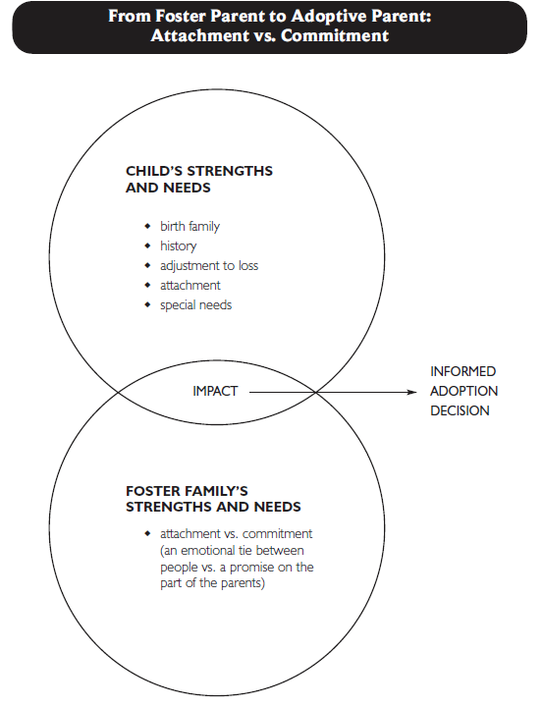
Let’s look at: Handout 3

Slide 31
Attachment vs. Commitment
Why is it helpful for foster parents to distinguish between attachment and commitment when making the decision to adopt a child in care?

Slide 32
Factors That Will Help a Foster Parent Adoption Be Successful:

Slide 33
Video: Richard
Placeholder

Slide 34
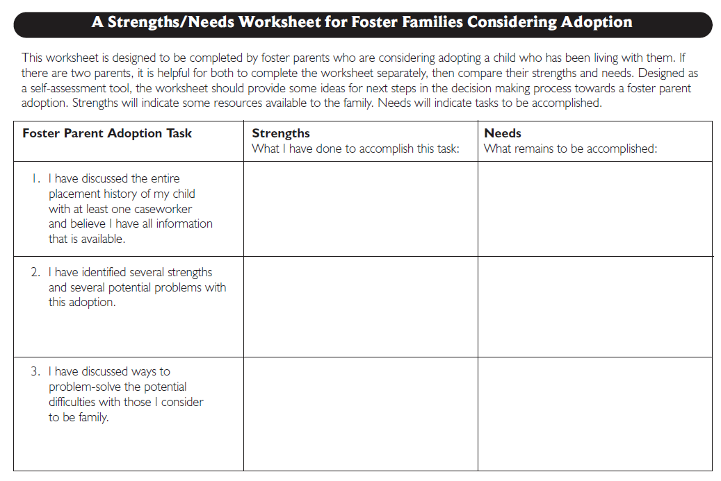
Let’s look at: Handout 4

Slide 35
Twelve Skills for Successful Fostering and Adopting
Know your family
Communicate Effectively
Know the children
Build strengths, meet needs
Work in partnership
Be loss and attachment experts
Manage behaviors
Build connections
Build self-esteem
10. Assure health and safety
Assess impact
Make an informed decision

Slide 36
Qualities of Effective Communication:

Slide 37
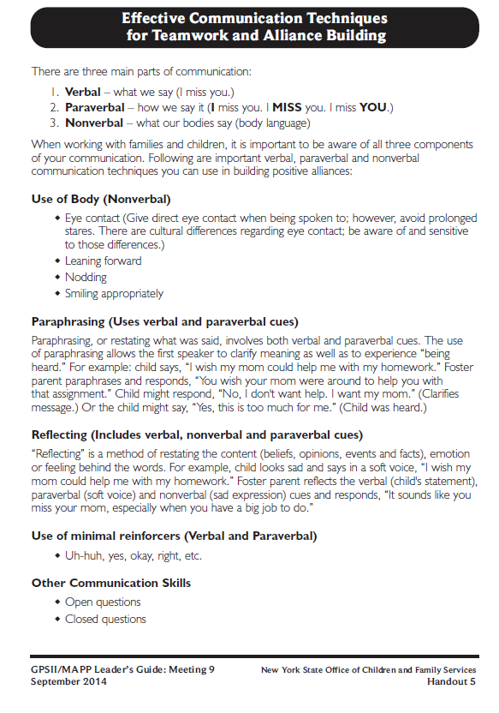
Let’s look at:
Handout 5

Slide 39
How Communication is Conveyed:
Verbal
(Words)
7%
Nonverbal
(Body)
55%
Paraverbal
(Tone)
38%

Slide 40
Family/Case Conference
Bringing together key stakeholders involved with a family and child to review progress, to assess strengths and needs, and to plan with the family.

Slide 41
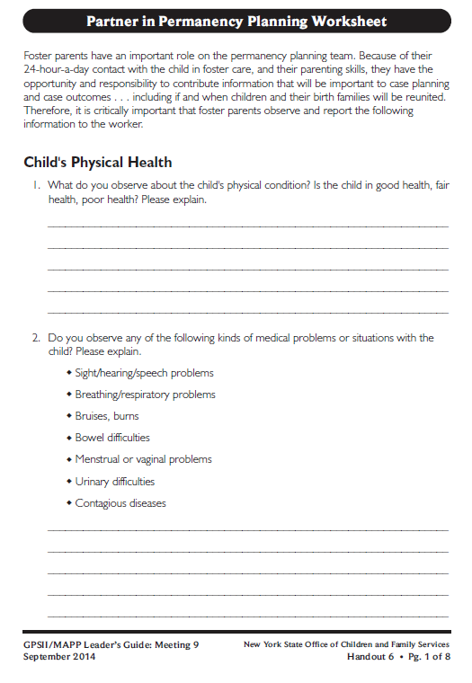
Let’s look at:
Handout 6

Slide 42
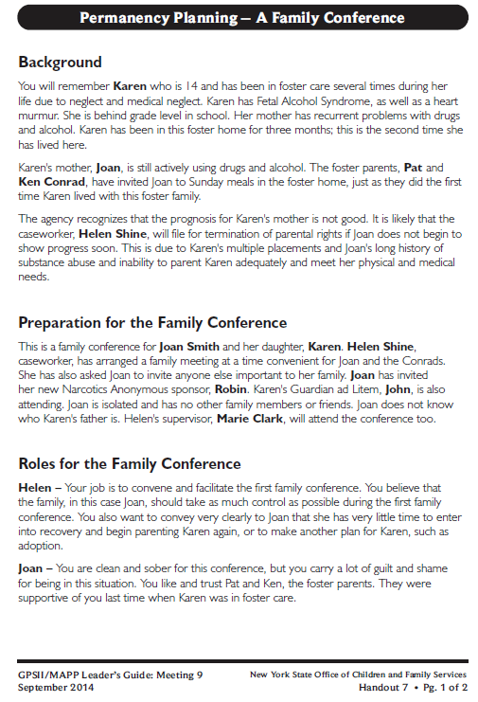
Let’s look at:
Handout 7

Slide 43
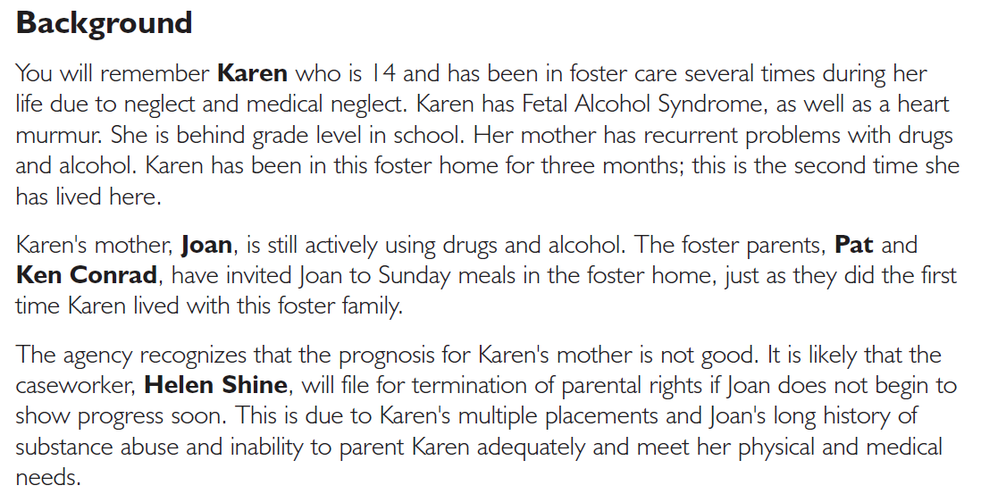

Slide 45
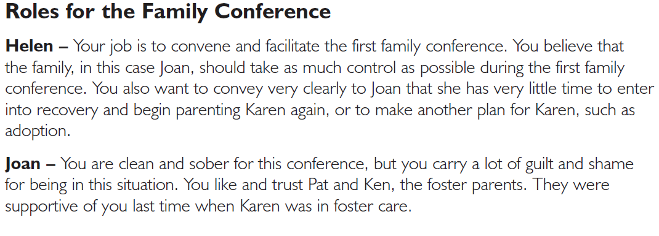

Slide 46
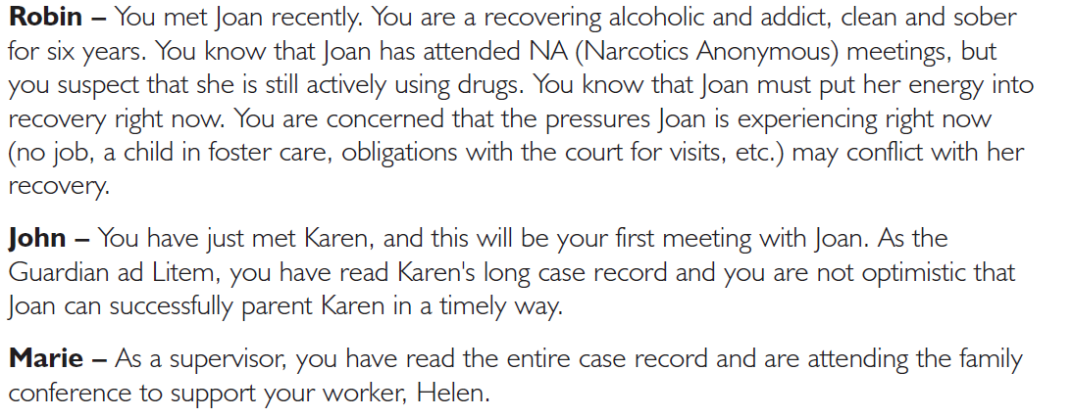

Slide 48
Preparation Questions:
What is important about the team relationship between the foster parents and the caseworker during family conferencing?
What are some of Karen’s needs in the conference?
What are Joan’s needs in the conference?

Slide 49
Order of Introductions
Helen (Caseworker)
Joan (Parent)
Karen (age 14)
Pat (Foster Parent)
Ken (Foster Parent)
Robin (Narcotics Anonymous Sponsor for Joan)
John (Guardian ad Litem for Karen)
Marie (Supervisor)

Slide 50
Family Conference Process Questions
Volunteers:
Please share one word that describes how you were feeling at the beginning of the conference.
Everyone:
What do you think went well in this conference?
Everyone:
What would you like to happen if the conference continued?

Slide 51
Twelve Skills for Successful Fostering and Adopting
Know your family
Communicate Effectively
Know the children
Build strengths, meet needs
Work in partnership
Be loss and attachment experts
Manage behaviors
Build connections
Build self-esteem
10. Assure health and safety
Assess impact
Make an informed decision

Slide 52
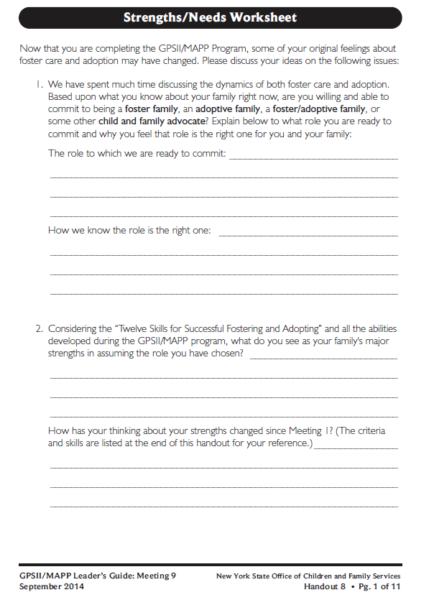
Roadwork:
Handout 8

Slide 53
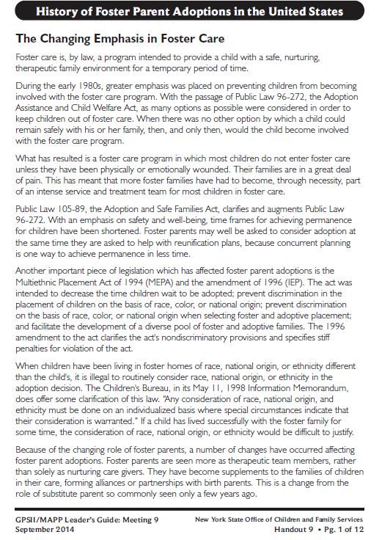
Roadwork
Reading:
Handout 9

Slide 54
Roadwork
Complete your final “Strengths/Needs Worksheet”
Read Handouts 7 and 9

Slide 55
It’s Time for a PIP!
Partnership
In
Parenting Experience

